Slide 1
Crime in Los Angeles
Samraj Moorjani and Revanth Bobba
Notes:
https://plot.ly/~smoorjani/0/#/

Slide 2
Description of Our Dataset
Data is from 2010-2017 Los Angeles Police Department Census
Each row represents a crime and there are 26 attributes of each crime.
Includes Crime code, Address, Crime name, location (latitude/longitude), Demographics, etc
Took out crimes relating to death

Slide 3
Hindrances/Problems

Slide 4
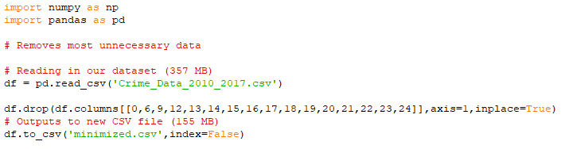
Size of Dataset
1.75 million rows and 26 columns
Removed many columns (MO code, status code, premise code, etc)

Slide 5
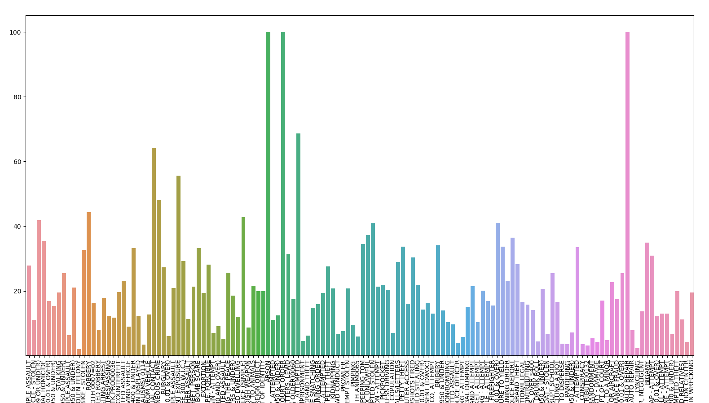
Graphing Data
High number of distinct crimes
Long crime names in certain cases

Slide 6
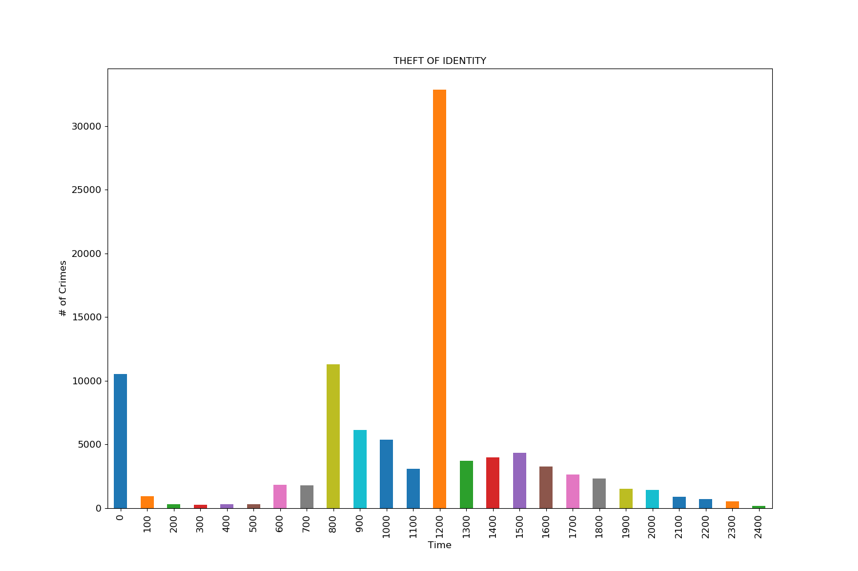
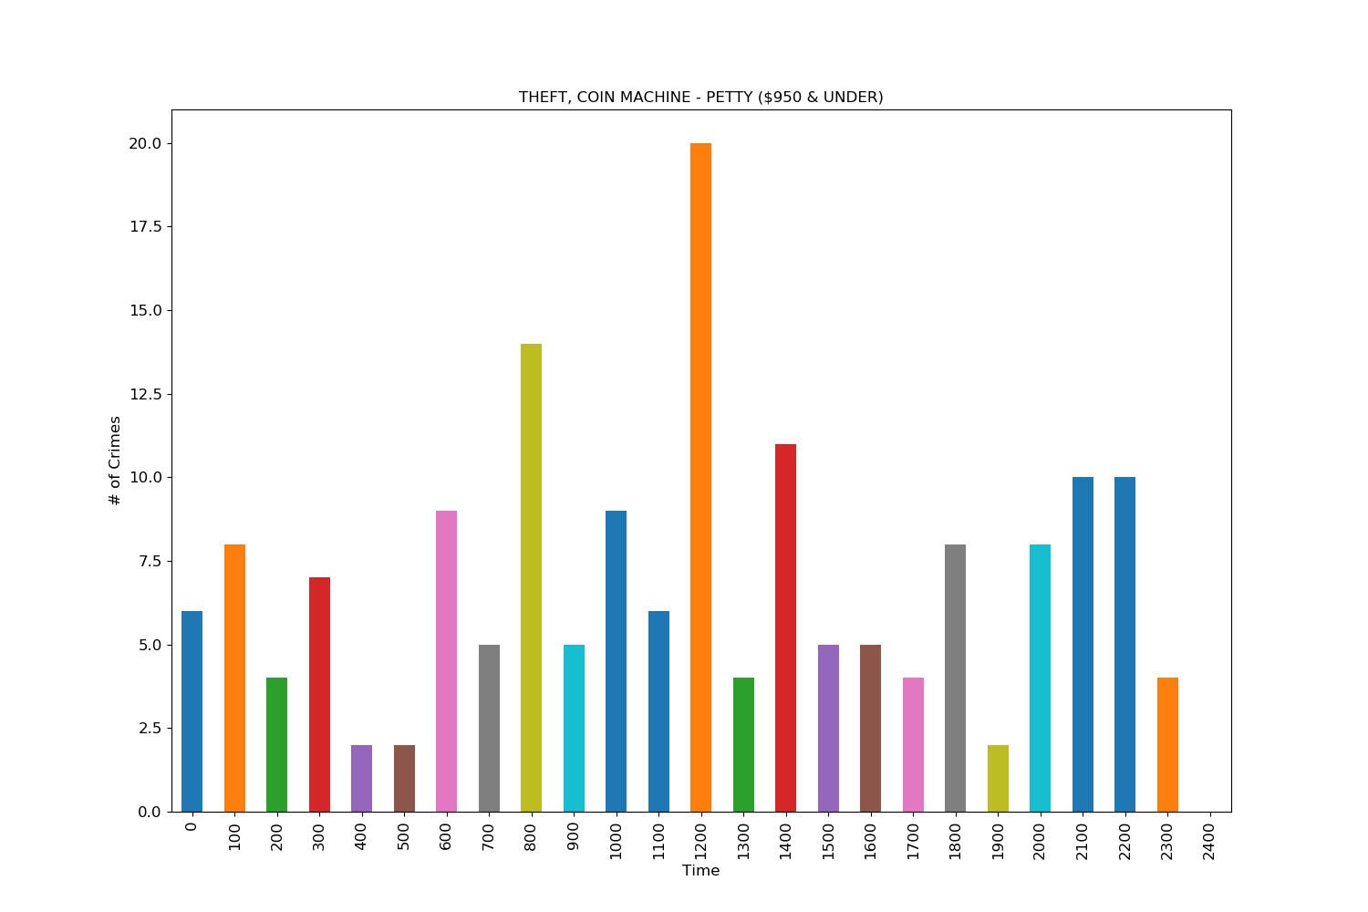
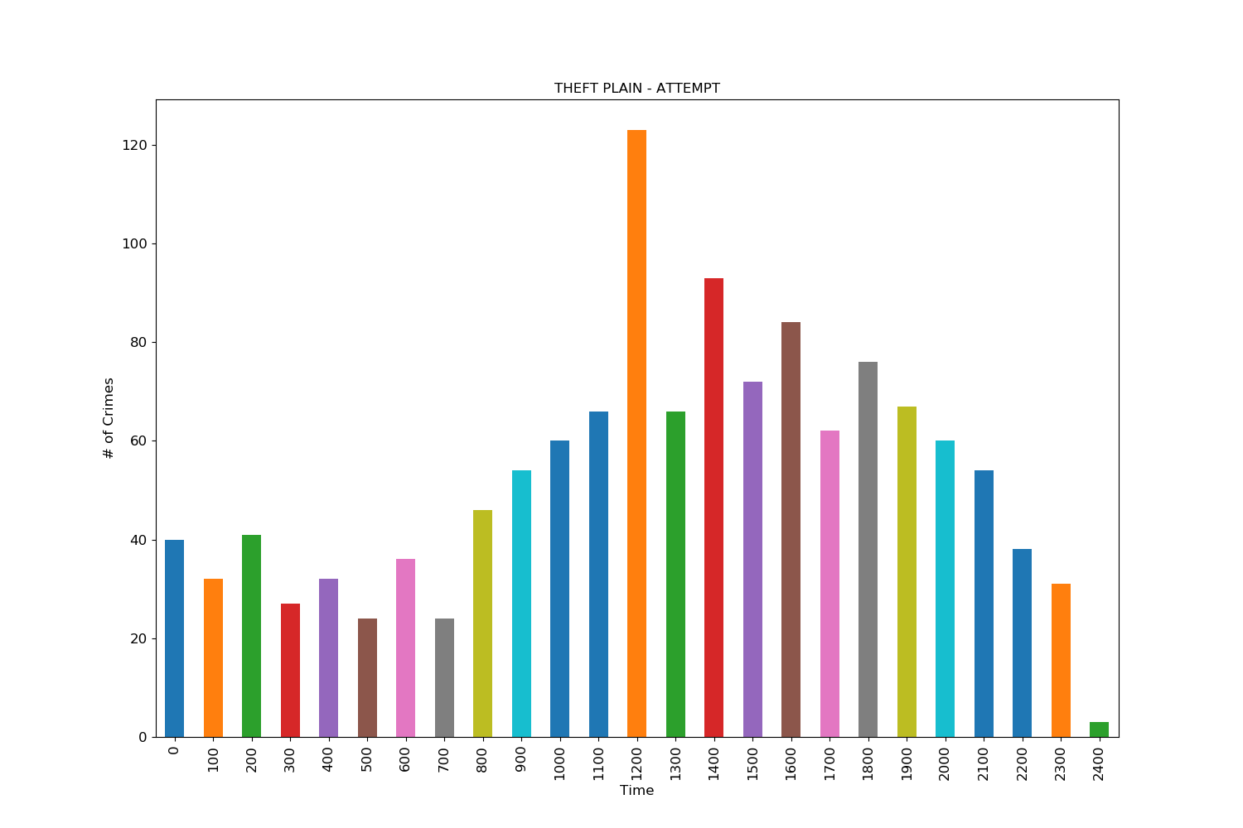
Inaccurate Data
Is there a default data entry?

Slide 7
Our 3 Questions
Question 1: Which areas in LA see more crime?
Question 2: Are certain crimes more frequently committed at certain times of the day?
Question 3: Is there a correlation between certain crimes and the demographics of victims (age and sex)?
Notes:
Different areas have different makeups (urban v. rural). Does this contribute to crime rates?
- Hypothesize that nightime

Slide 8
1. Which areas in Los Angeles see the most crime?

Slide 9
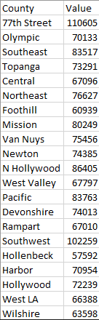
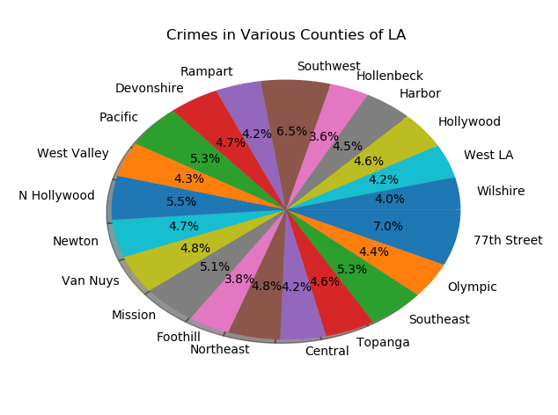
Crimes were somewhat uniformly distributed
Most - 77th Street (110605)
Least - Hollenbeck
(57592)
Mean of 75443.62 crimes

Slide 10
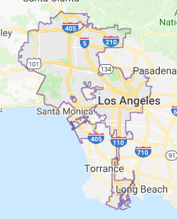
https://plot.ly/~smoorjani/0/#/

Slide 11
2. Are certain crimes more frequently committed at certain times of the day?
Notes:
https://stats.stackexchange.com/questions/5960/how-to-identify-a-bimodal-distribution

Slide 12
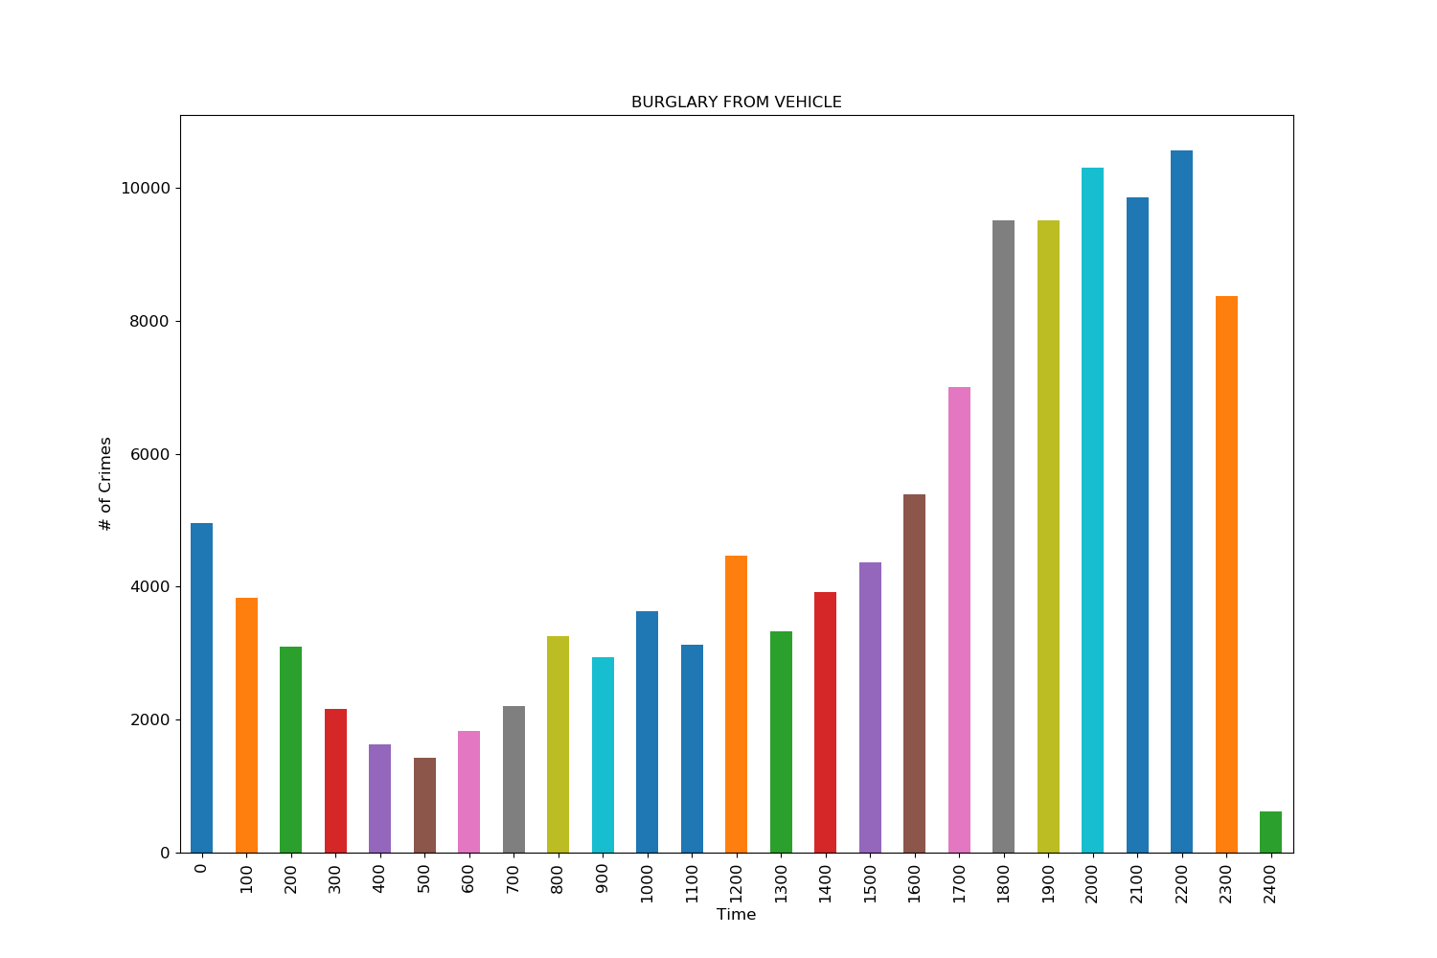

Slide 13
Scoring System
Use curve fit to determine curve of graph
Compare to an ideal curve for certain time of day (e.g. Night time would be a bimodal curve)
Score based on differences between the two curves
Note: Most values that are equal to 100.0 only have one occurrence. There are a good deal of crimes which only have a few occurrences.

Slide 14
Scoring System
Scoring based on a scale of 1-100
0 is most equal in occurrences throughout the day
i.e. 25.0%,25.0%,25.0%,25.0%
100 is least equal in occurrences throughout the day
i.e. 100.0%,0.0%,0.0%,0.0%
Note that percentages are organized by:
Morning (6am to 12pm) , Afternoon (12pm to 5pm), Evening (5pm to 9pm), Night (9pm to 6am)

Slide 15
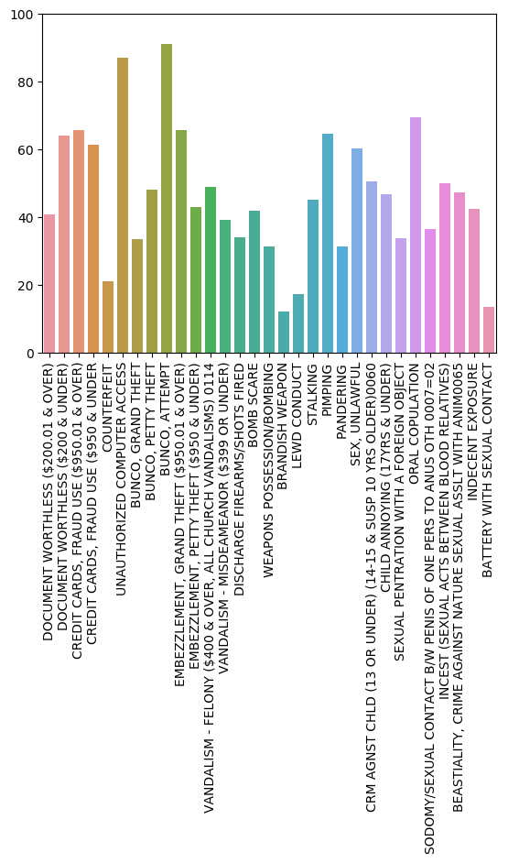
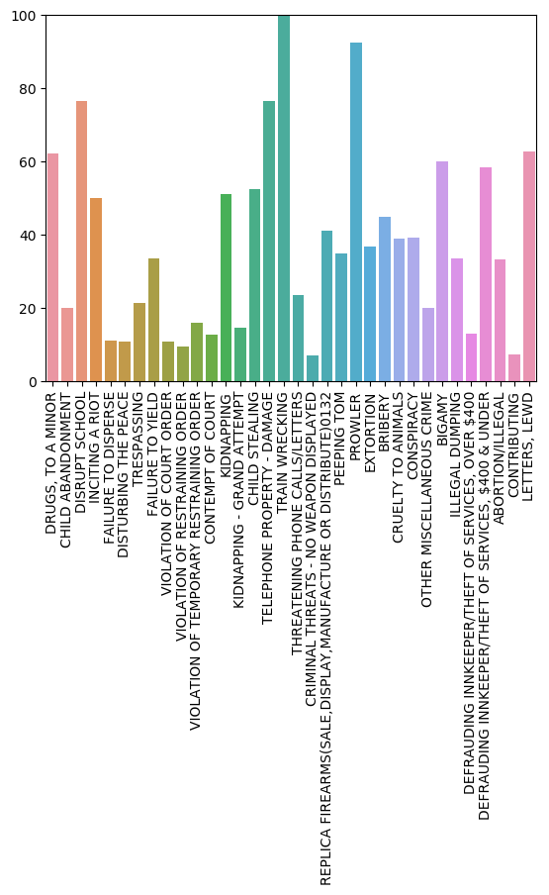

Slide 16
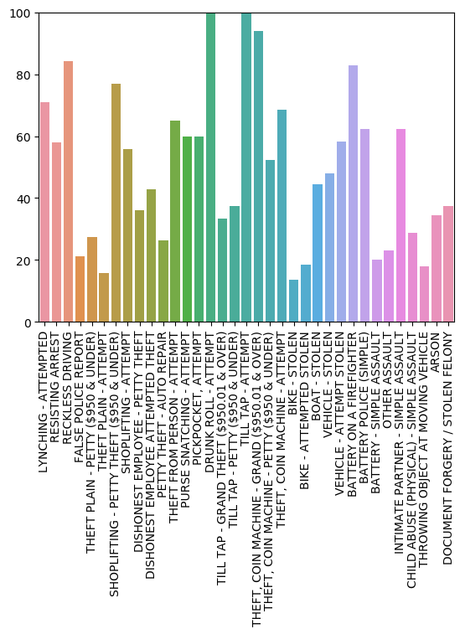
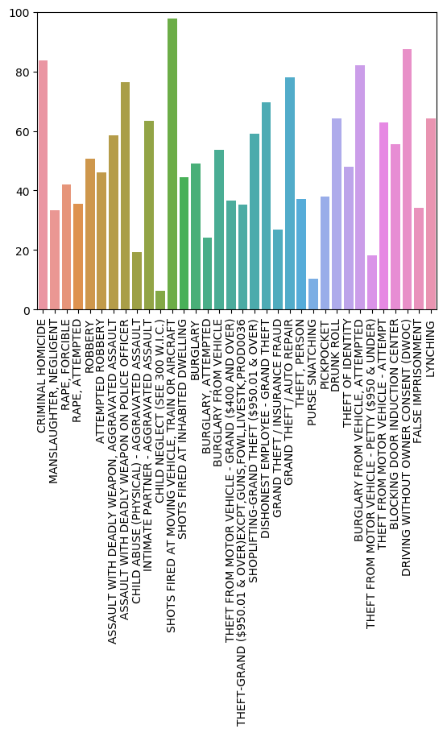

Slide 17
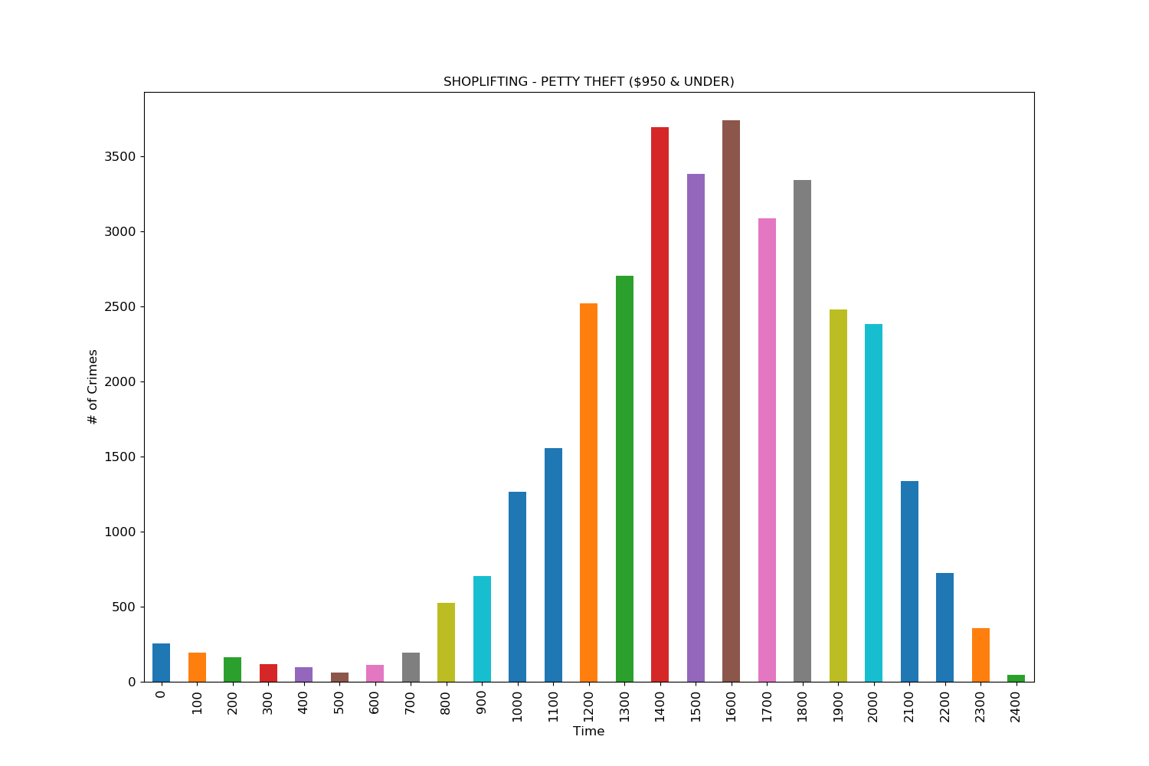
Shoplifting - Petty Theft (Under $950)
Time Dist. Score: 77.62
44.2% occurred in the afternoon and 32.2% in the evening

Slide 18
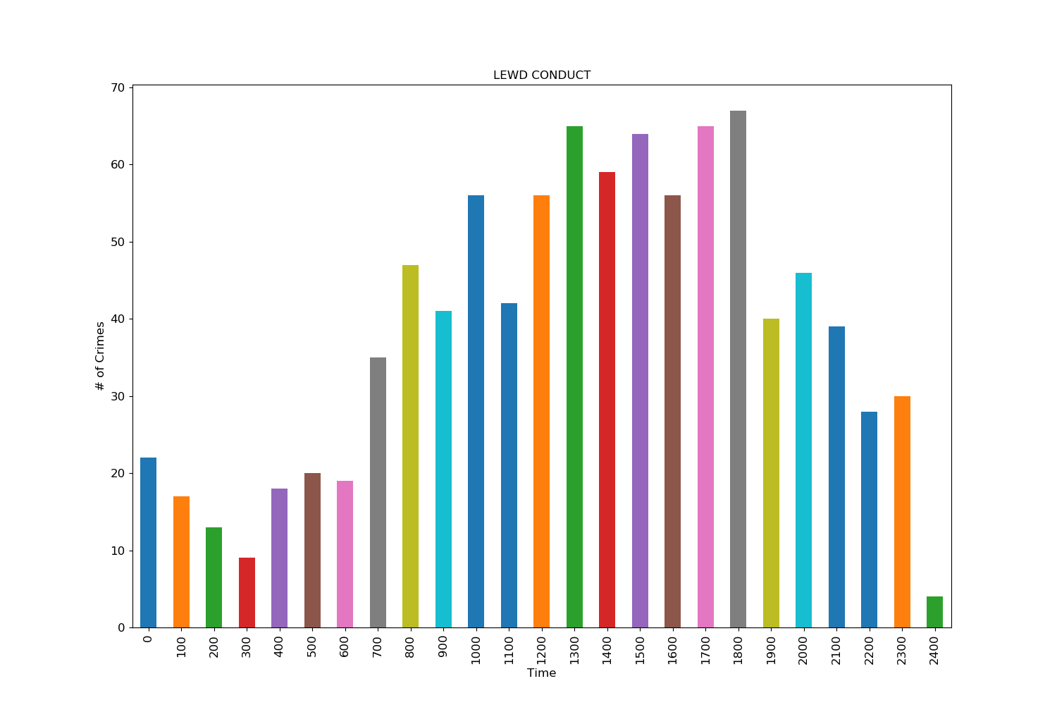
Lewd Conduct
Time Dist. Score: 27.63
Morning: 28.72%
Afternoon: 32.33%
Evening: 22.86%
Night: 16.09%

Slide 19
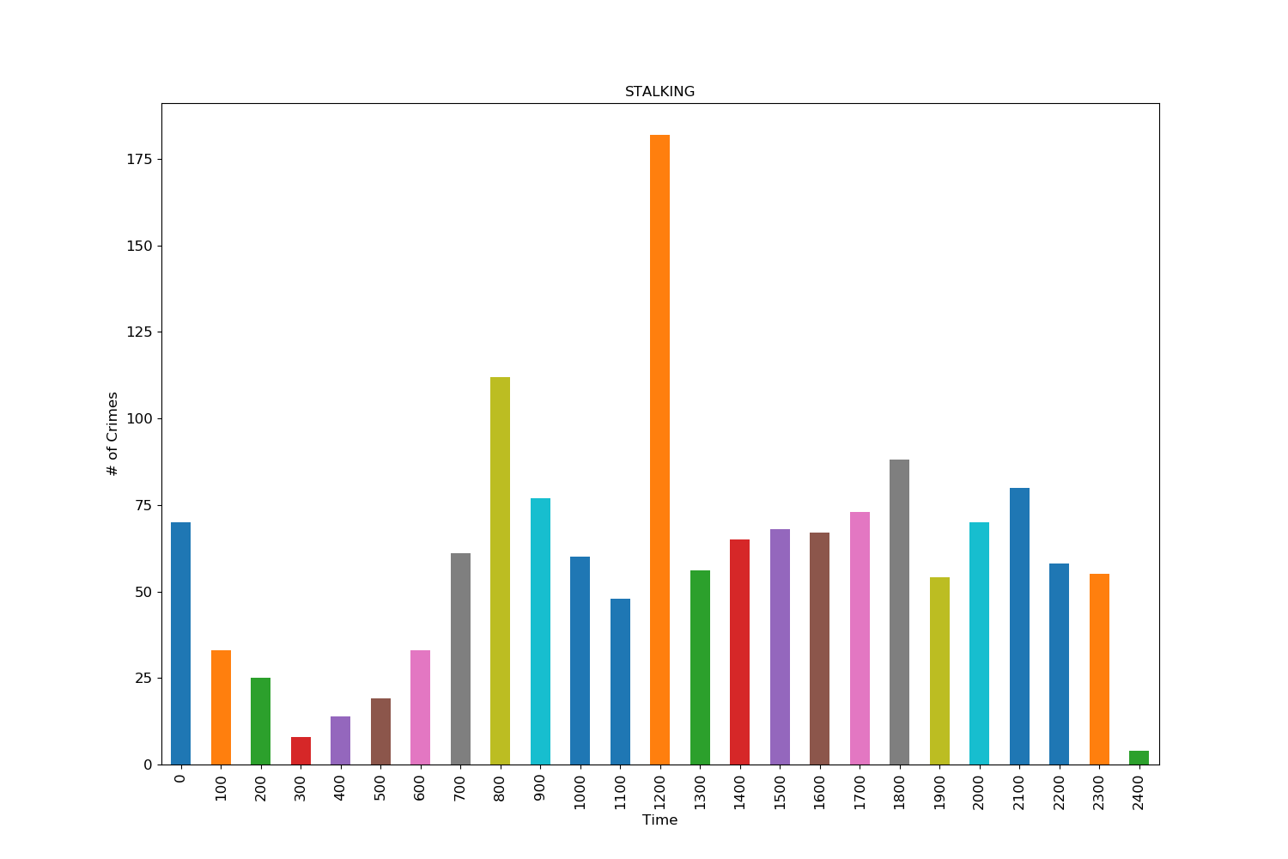
Stalking
Time Dist. Score: 36.13
Morning: 36.28%
Afternoon: 19.73%
Evening: 19.32%
Night: 24.66%

Slide 20
3. Is there a correlation between certain crimes and the demographics of victims (age and sex)?

Slide 21
Scoring System
Scoring based on a scale of 1-100
0 is most equal in percentages of ages affected
100 is least equal in percentages of ages affected
Note: results will be slightly inflated since most children and senior citizens are not as affected by crimes

Slide 22
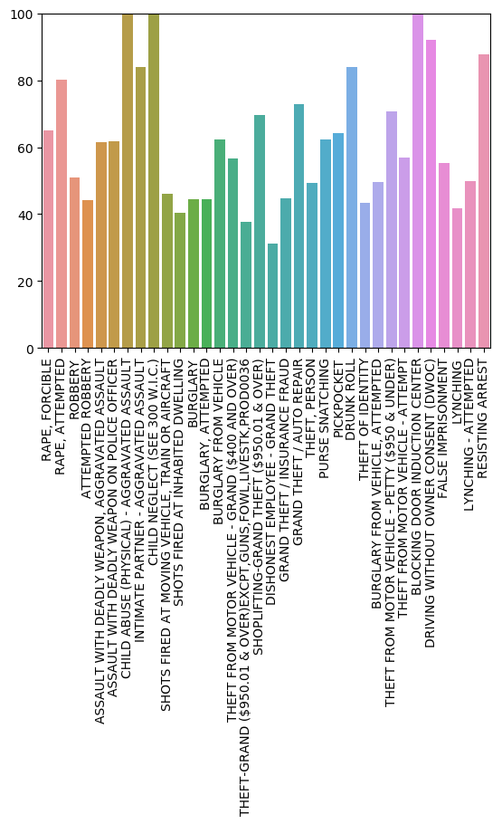
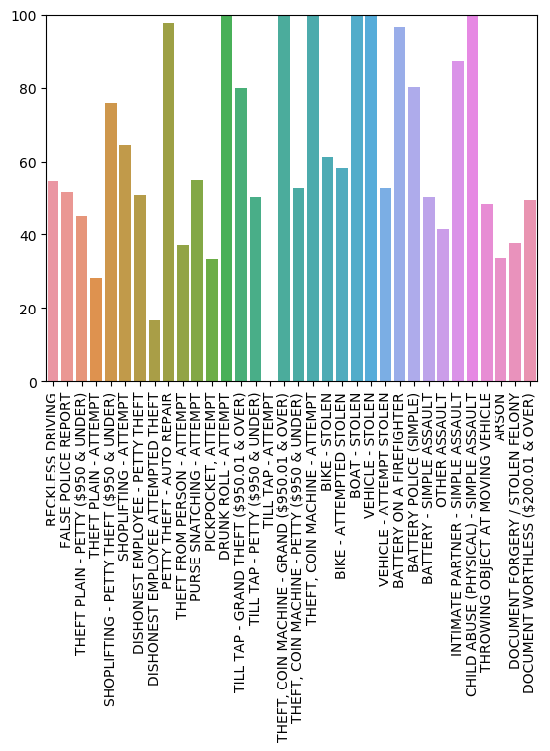

Slide 23
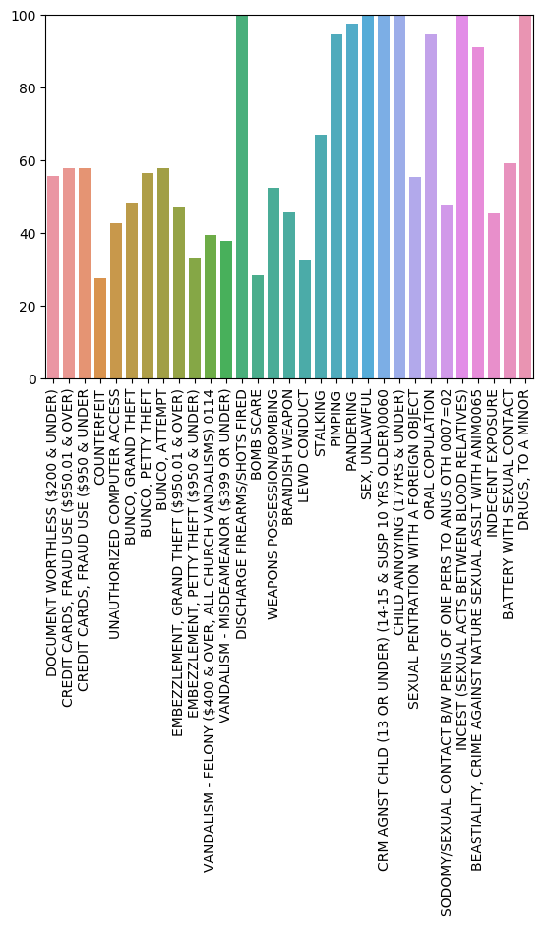
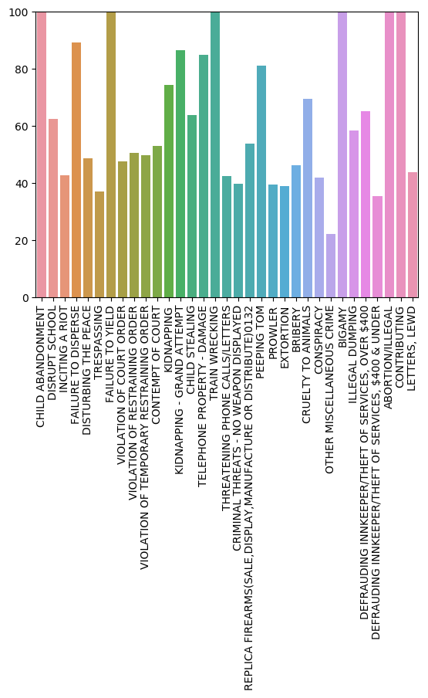

Slide 24
Scoring System for Gender
Scoring based on a scale of 1-100
0 is most equal in percentages of genders affected
100 is least equal in percentages of genders affected
Found using average difference between each gender’s percent

Slide 25
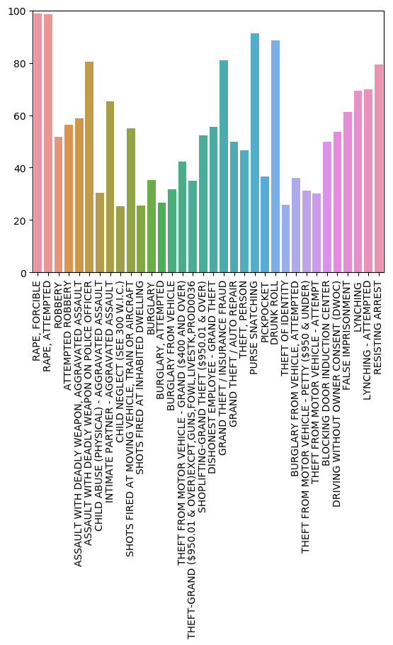
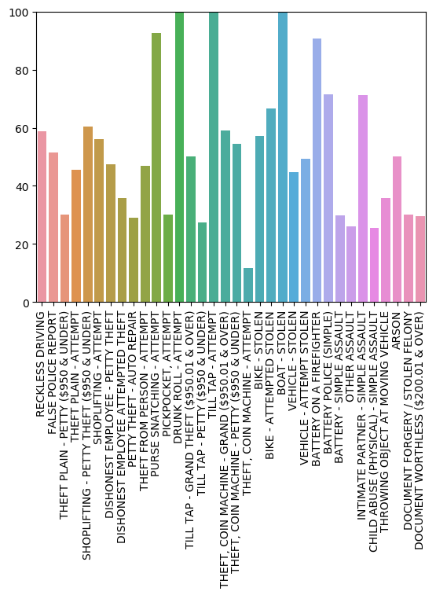

Slide 26
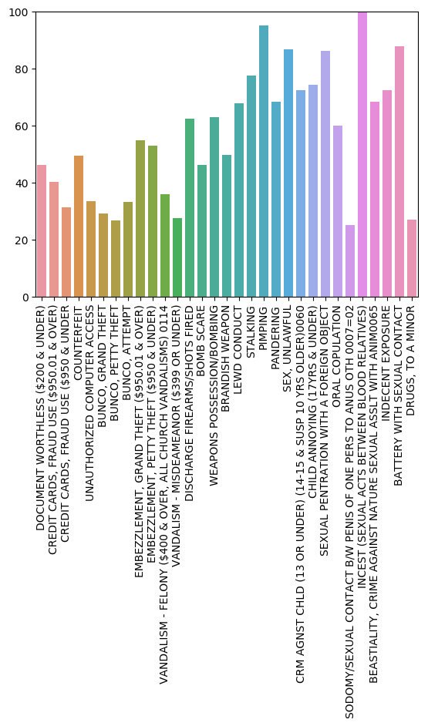
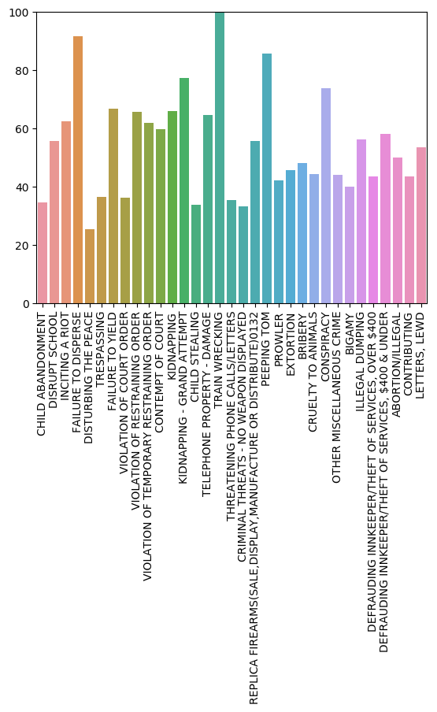

Slide 27
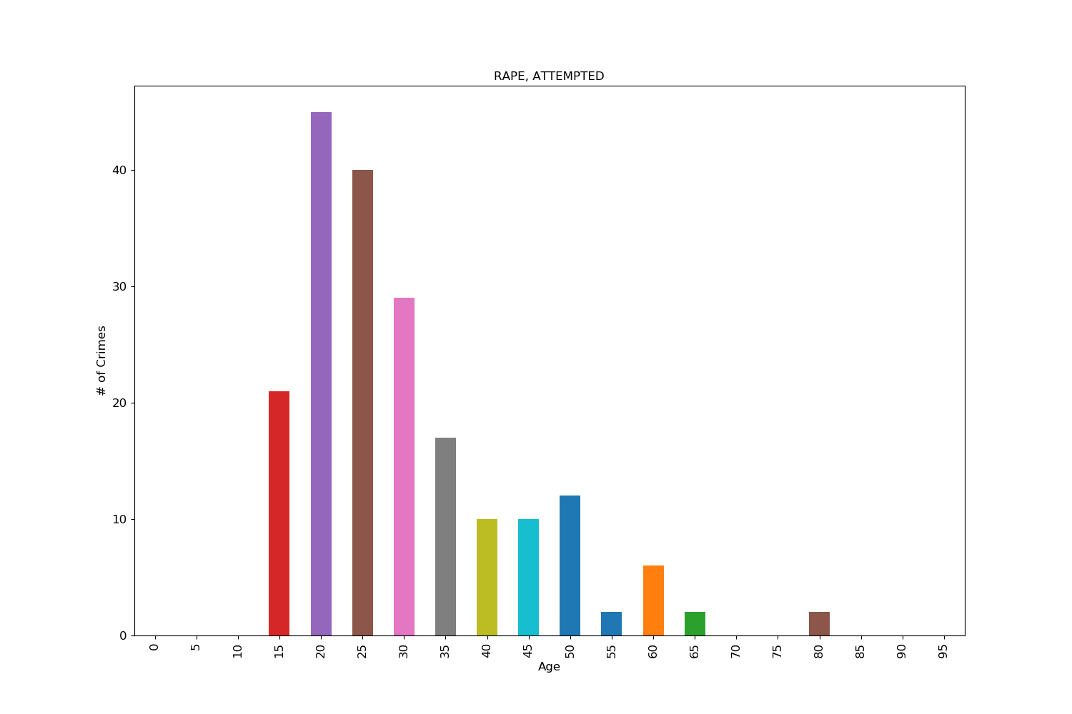
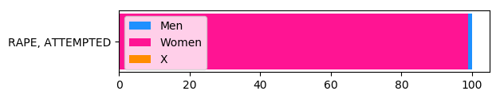
Attempted Rape
Age Score: 80.74
Gender Score: 98.45

Slide 28
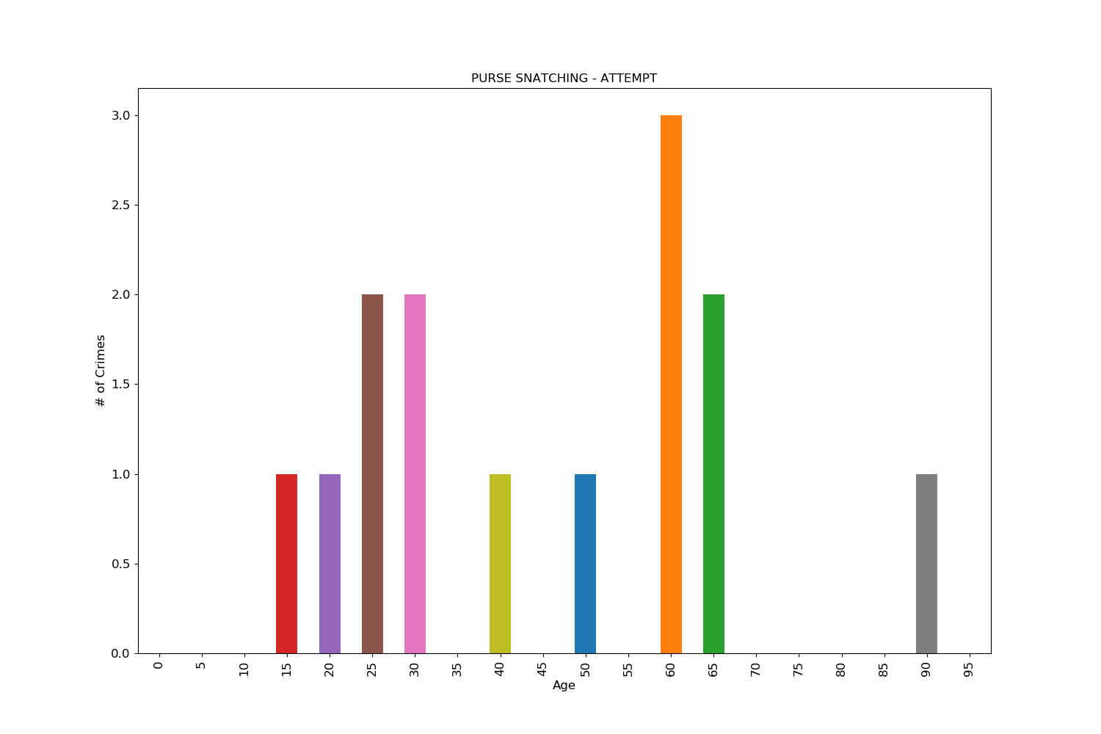
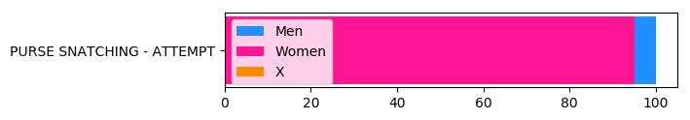
Attempted Purse Snatching
Age Score: 55.00
Gender Score: 95.00

Slide 29
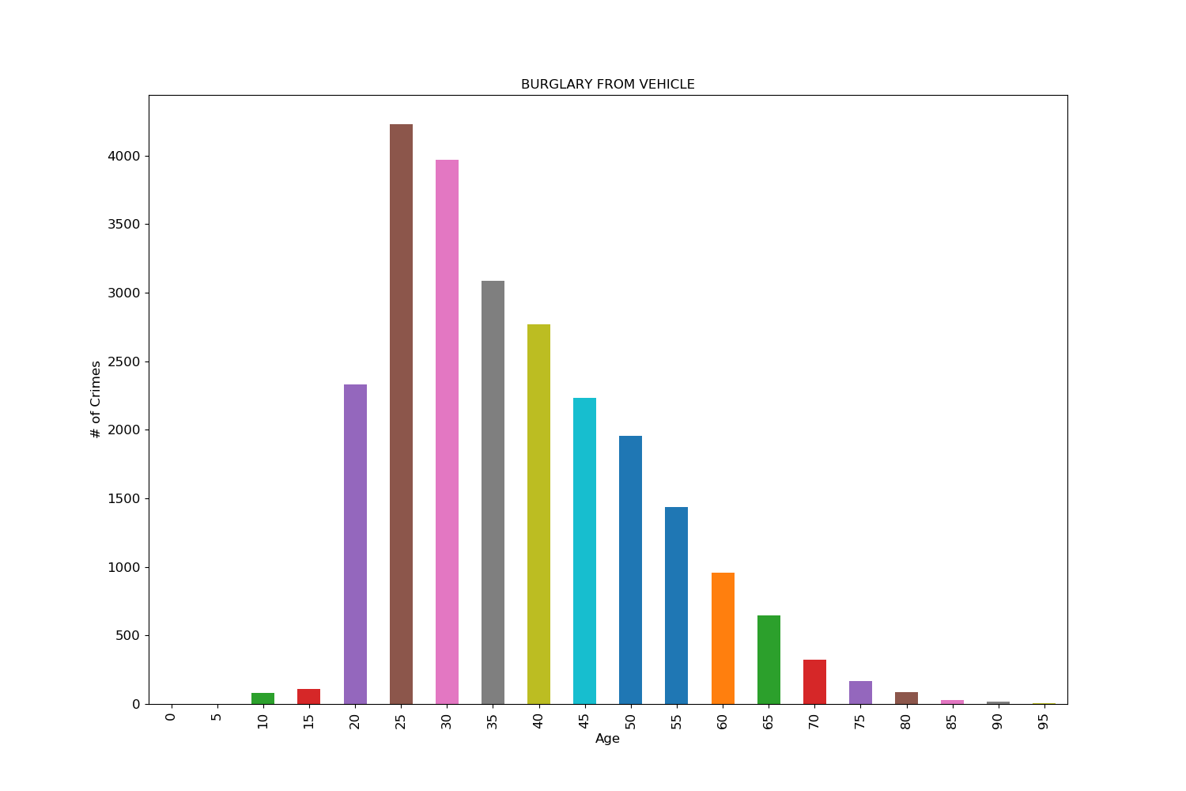
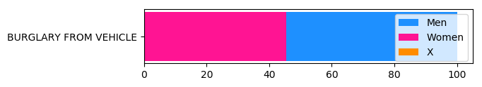
Burglary from Vehicle
Age Score: 62.27
Gender Score: 9.72

Slide 30
Conclusion

Slide 31
Things we wished we had
Information about the offenders as opposed to just the victims
Population of each area (numbers weren’t very accurate online) to better gauge the rate of crime
Complete demographics (e.g. ethnicity, income, etc)

Slide 32
Conclusion
Crime was distributed fairly evenly among the different areas in Los Angeles
There were certain crimes like shoplifting and bunco attempts which were more common in certain parts of the day while others were evenly spread out
The same goes for the age aspect, with some like pimping being more common in certain age groups
Some crimes have a strong correlation with gender

Slide 33
Thanks for Watching!

